Slide 1
Stanford ME469: A Validation Methodology:
Code and Solution Verification
Stefan P. Domino
Computational Thermal and Fluid Mechanics
Sandia National Laboratories SAND2018-4536 PE

Slide 2
A Validation Methodology: Code and Solution Verification: Outline
Elements of a Poor-Quality Validation Study
Elements of a High-Quality Validation Study
Overview of a Phenomena Identification Ranking Table (PIRT)
Solution Verification
The Role of Code Verification, including the Method of Manufactured Solutions (MMS)
Code Verification: Value Proposition
Review
Conclusions

Slide 3
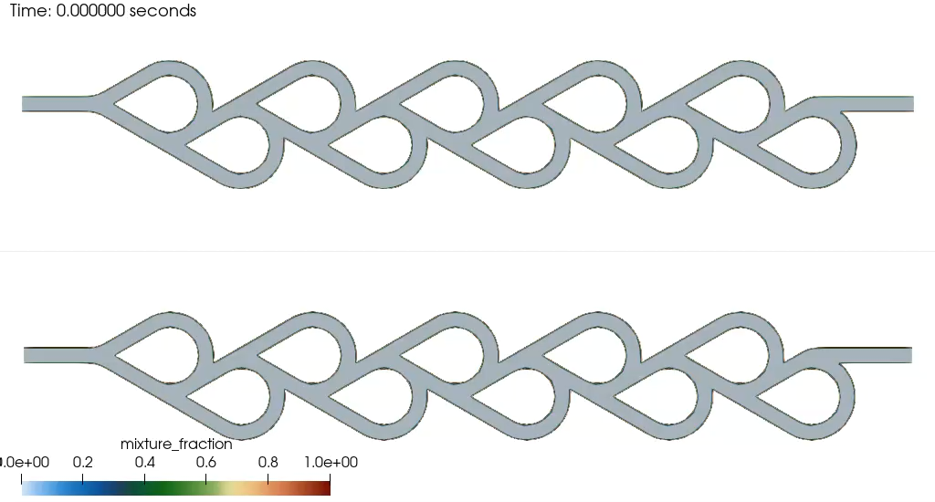
Brain Teaser….
??

Slide 4
Brain Teaser…. Tesla valve….

Slide 5
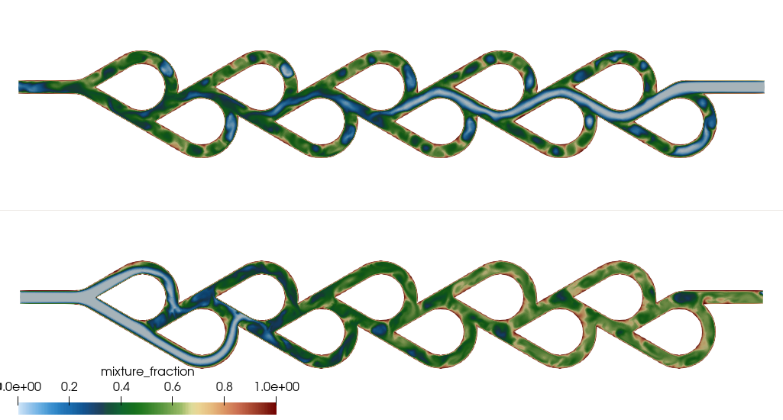
Brain Teaser…. Tesla valve….

Slide 6
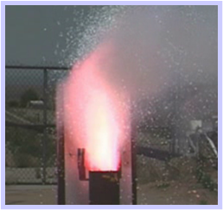
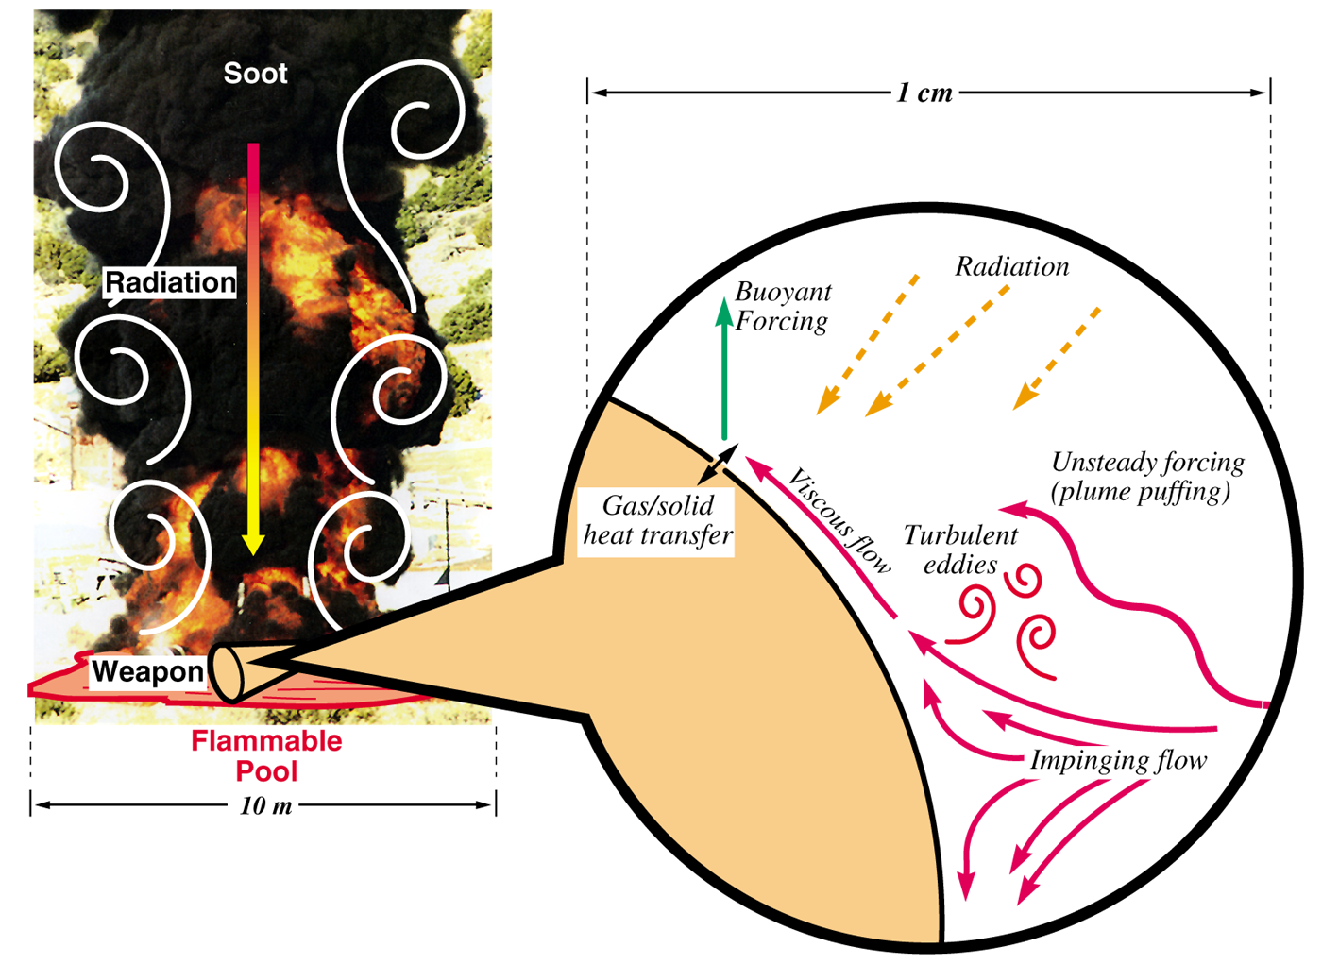
Heat Transfer Mechanisms: Abnormal/Thermal Environment (ATE)
Characterized by a highly sooting, turbulent reacting flow with participating media radiation (PMR) and conjugate heat transfer (CHT) multi-physics coupling
Liquid fuels, e.g., JP-8, are common due to its usage in transportation, however, propellants (point-Lagrangian/Eulerian) and composite (heterogeneous combustion) also encompass the ATE
Propellant upward burn
[1]
object
[1] https://en.wikipedia.org/wiki/2008_Andersen_Air_Force_Base_B-2_accident
Anderson Air Force B-2 Accident (2/2008)

Slide 7
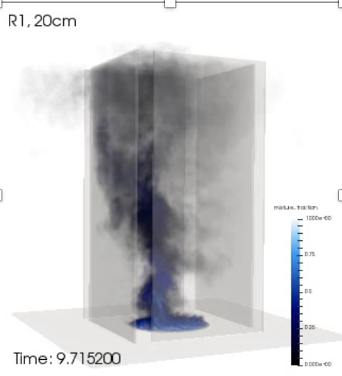
Objective: Deploy a High-Fidelity Tool to Predict a Fire with External Flow Coupling
Consider that we want to develop and deploy a foundational understanding in fire physics and deploy a simulation tool to support production analysis
Consider the fire-environment with elements of the following physics:
Chemical reactions, soot, buoyancy, turbulent fluid mechanics, thermal radiation heat transfer, convective heat transfer, object heat-up/response, and sometimes propellants
As mixing increases, accurately capturing convective heat loads become important
Volume rendered mixture fraction

Slide 8
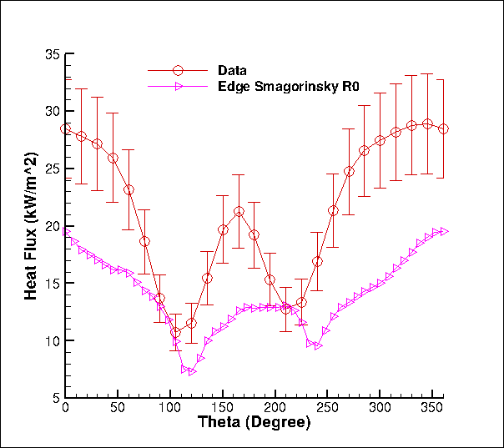
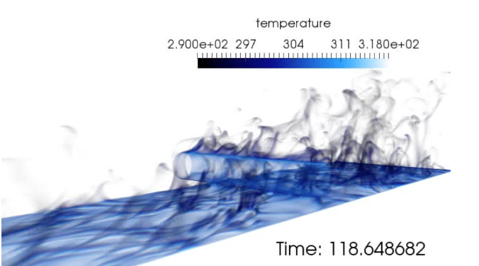
Conceptual Challenge: Distinguishing Between Model-form Error, Discretization Error, and Code Error
One mesh, one model, no code pedigree…
What credible scientific hypothesis can be tested in this context?
Was a Phenomenological Identification and Ranking Table (PIRT) conducted:
Process that defines 1) what you know, 2) what you think you know, and 3) what “you know not of”
Heat flux to the cylinder
Volume-rendered temperature
Time-averaged heat flux to cylinder

Slide 9
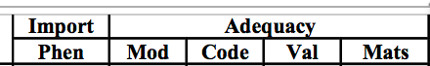
Step 1: Phenomena Identification and Ranking Table (PIRT)
Objective: Define a process that defines 1) what you know, 2) what you think you know, and 3) what “you know not of”
Once a particular use-case is understood and a PIRT is complete, one can proceed down the path of simply closing the gaps in the modeling, code implementation, and model validation process
Focus on one such element of convective heat transfer:
We think we have a good understanding of the modeling requirements
- and the code seems to have the models that we want – given our current understanding
However, high-quality validation experimental data is missing
Investment: Experimental campaign for mixed-convective heat transfer

Slide 10
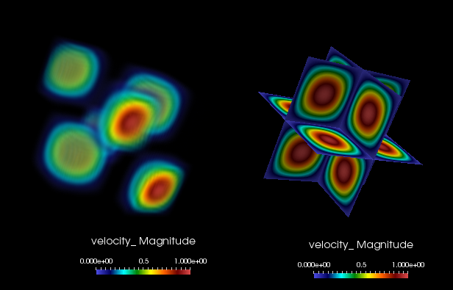
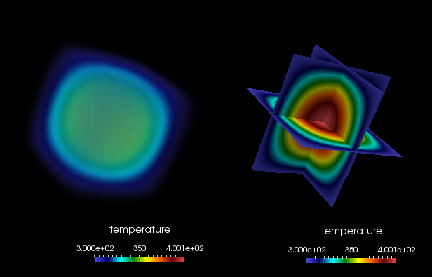
Spatial Code Verification for a low-Mach, Variable-Density Flow
Density is a function of static enthalpy transport via the standard ideal gas, ρ = f(P,M,R,T)
Temperature range maps to experiment
Arbitrary buoyancy source term via rotated gravity vector
Collective study now provides confidence in the interplay between numerical and modeling accuracy
Velocity Mag
Temperature

Slide 11
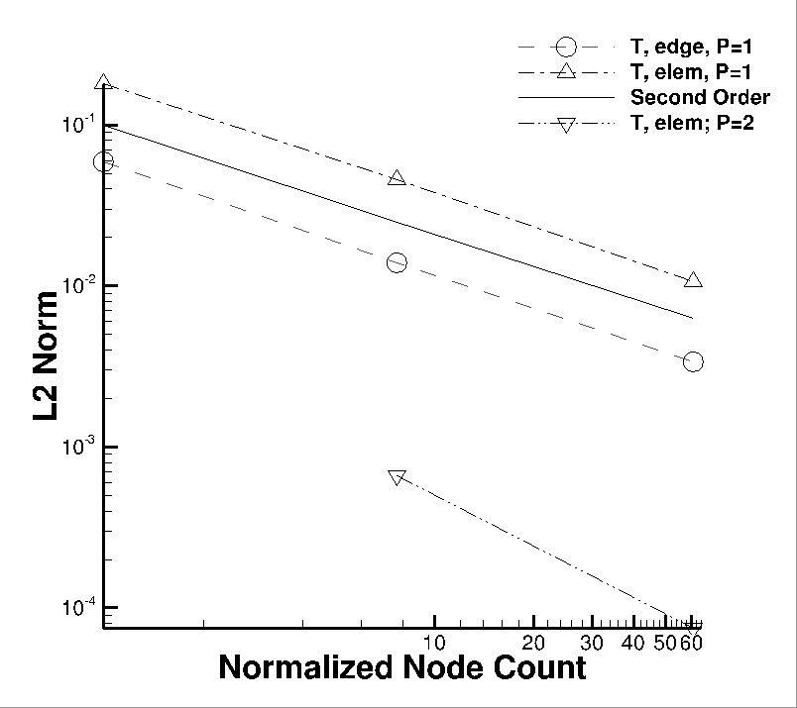
Spatial Code Verification for a low-Mach, Variable-Density Flow
Density is a function of static enthalpy transport via the standard ideal gas, ρ = f(P,M,R,T)
Temperature range maps to experiment
Arbitrary buoyancy source term via rotated gravity vector
Collective study now provides confidence in the interplay between numerical and modeling accuracy
See, “Exploring model-form uncertainties in large-eddy simulations”, Domino et al, 2016
Velocity Mag
Temperature

Slide 12
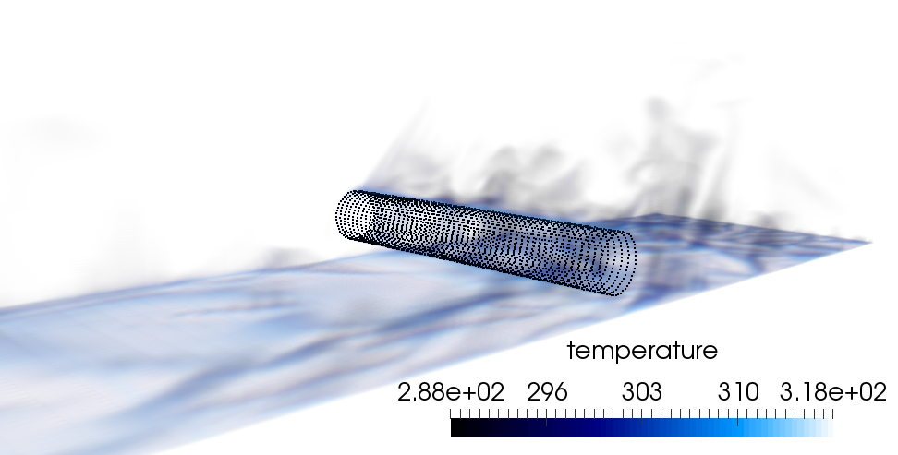
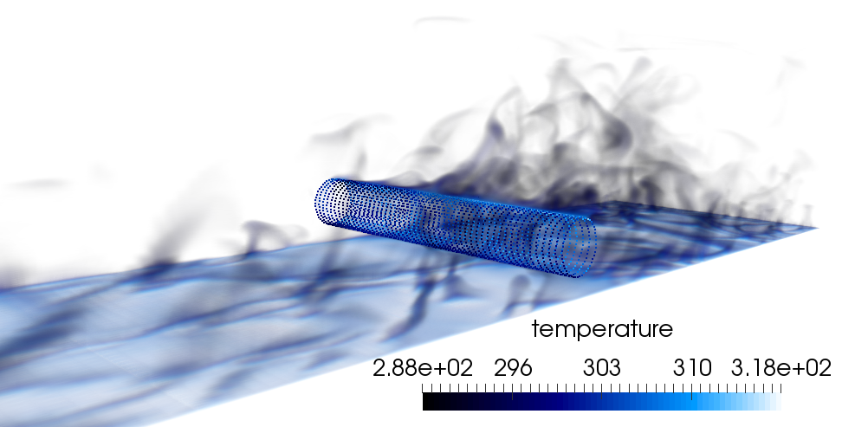
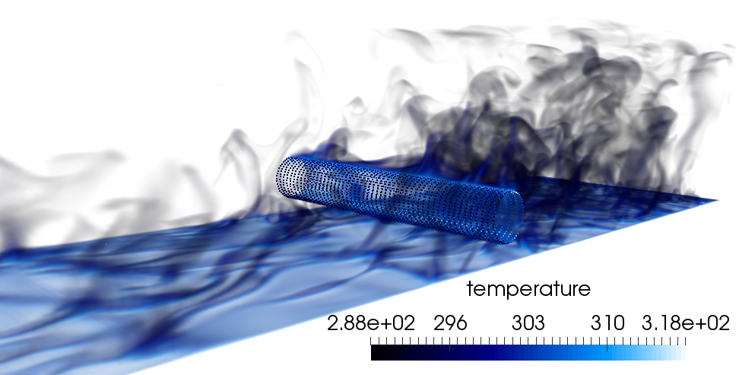

The Effect of Polynomial (P) and Mesh Spacing (H) Refinement
For the heated cylinder-in-cross flow, either mesh resolution or polynomial promotion provides a more accurate result with more turbulence structure noted
P=1, R0
P=1, R1
P=1, R2
P=2, R0

Slide 13
Solution Verification and Due Diligence for Model-form (Structural) Uncertainty
Three meshes, three models
The heat flux results also show error bars due to time and spatial averaging over a line-of-site

Slide 14
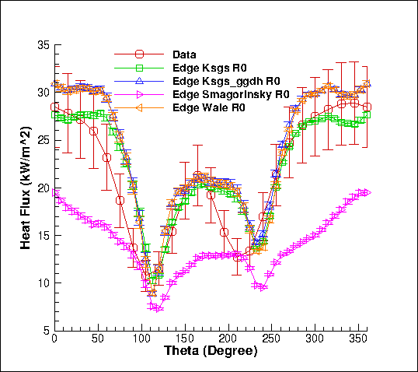
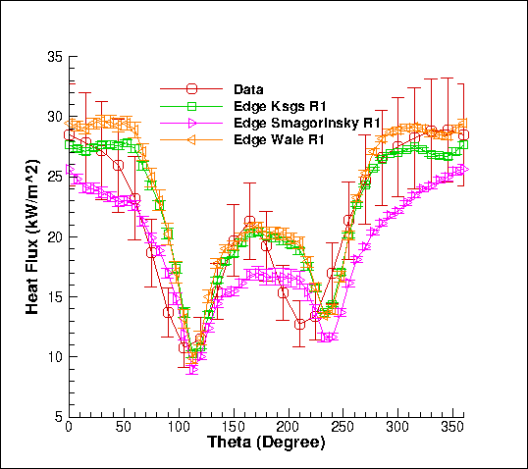
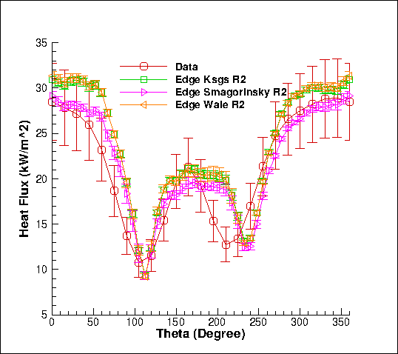
Solution Verification and Due Diligence for Model-form (Structural) Uncertainty
Three meshes, three models
The heat flux results also show error bars due to time and spatial averaging over a line-of-site
Can we yet feel confidence in any scientific statement?

Slide 15
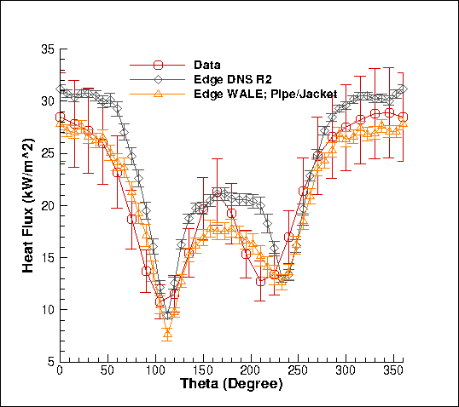
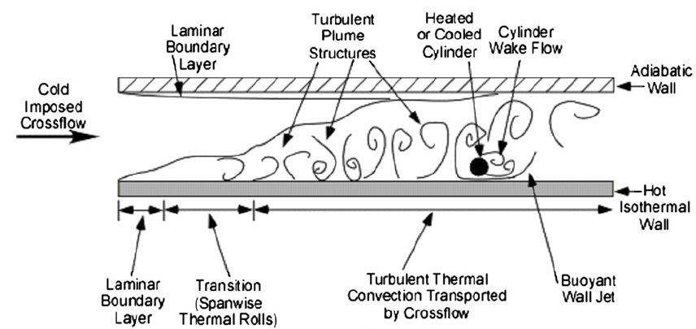
Review Case and Conceptual Model: Why are we not converging to the experimental result?
Model Configuration: SNL-based Sean Kearney Experiment, “Experimental investigation of a cylinder in turbulent convection with an imposed shear flow”, AIAA, 2005
Experiment: Outer crossflow, pipe wall, inner hot fluid
QoI: Heat flux… How was that obtained?
Inverse analysis! Experiment measured temperature and inferred heat flux; an additional error/uncertainty
Solution? Adding two fluid regions and a CHT coupling removed the conceptual error an usage of the inverse wall temperature… (Domino, 2019)
Domino et al., CTRSP, 2018
Kearney experimental configuration

Slide 16
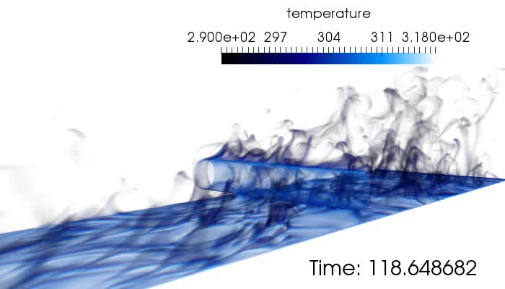
Review of a Strong V&V Process LES-based
Numerical UQ
Established a sound LES-based verification and validation process (with uncertainty quantification) that includes the following attributes:
Definition of key physics, Phenomena Identification Ranking Table (PIRT)
Code implementation and verification
Validation including solution verification (meshes with converged statistics)
Structural uncertainty, i.e., model form, quantification
Physics assumptions, i.e., your conceptual model
Structural UQ
Non-isothermal MMS
Physics UQ
10x
reduction
“An assessment of atypical mesh topologies for low-Mach LES”, Domino et al., Comp & Fluids, 2019

Slide 17
How Code Verification Can Guide Numerical Methods Elucidation

Slide 18
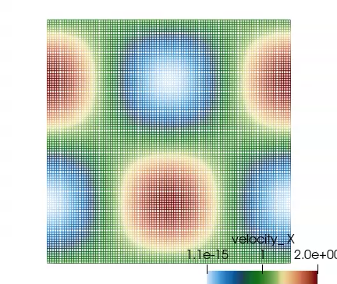
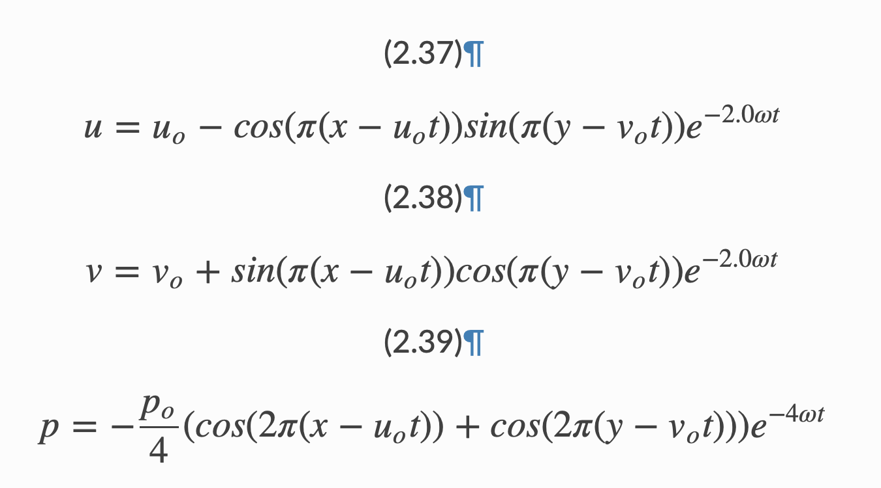
Consistent vs Lumped Mass Matrix
Goal: Explore the time accuracy of the consistent mass matrix approach on a structured mesh
Convecting Taylor Vortex Case Study: Analytical, transient verification problem
Process: Compute error at a specific time while refining mesh

Slide 19
Code or Conceptual Error? Part 1: Time Splitting
Case Study: An Algorithm is thought to be second-order-in-time accurate with one nonlinear iteration: True or False?
“Solution of the implicitly discretized fluid flow equations by operator splitting”, R. Issa, JCP, 1985.
Advent of the “Pressure-implicit with Splitting of Operators”, or PISO
PISO is a scheme that defines a series of predictors and correctors in the context of a fully implicit solve
The precise details are not of interest, rather the claim that the scheme is second-order accurate in absence of nonlinear iterations…
Conclusion? Sometimes we code correctly, however, have a conceptual error in our understanding of whether or not a scheme is design-order accurate when run in the suggested manner

Slide 20
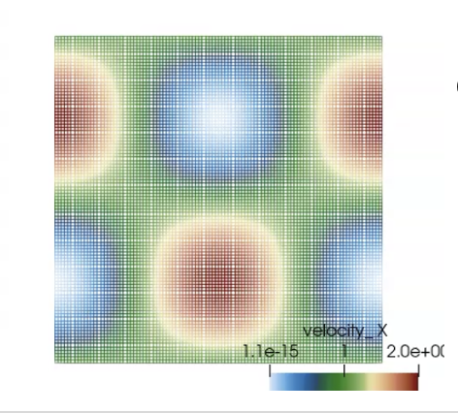
Code or Conceptual Error? Part 2: Boundary Conditions
Case Study: Using the convecting Taylor Vortex case, explore boundary conditions
Choice 1: Periodic with specified initial condition
Requires no formal boundary conditions
Choice 2: Inflow
Easy, velocity is specified
What about pressure? The default approach is to assume a zero normal pressure gradient (no-op) – similar to what would be found at a wall
A notion of a “spurious numerical boundary layer” (Gresho, 1995) shows a characteristic length δ ~ sqrt(νΔt)
We also need to make sure that we are adequately converging the nonlinear system within the time step

Slide 21
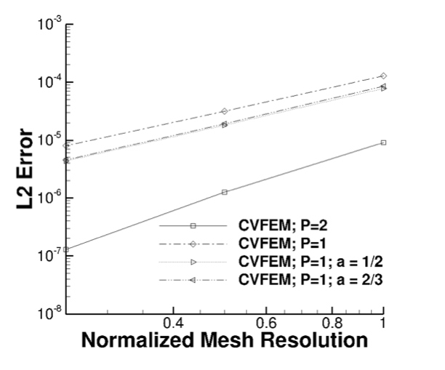
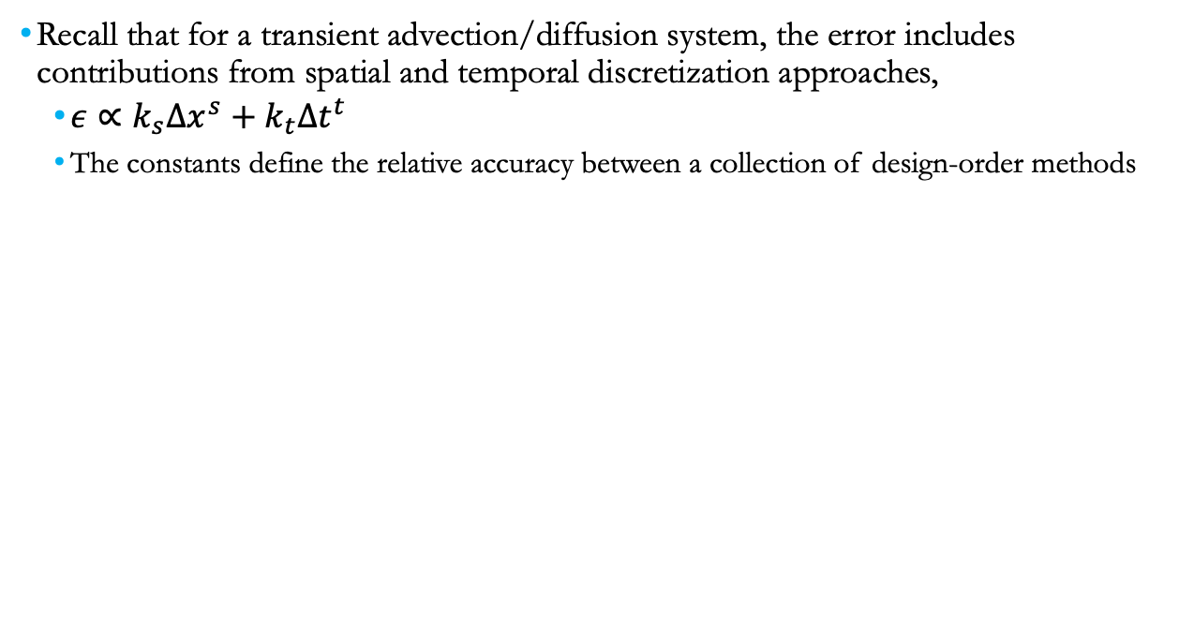
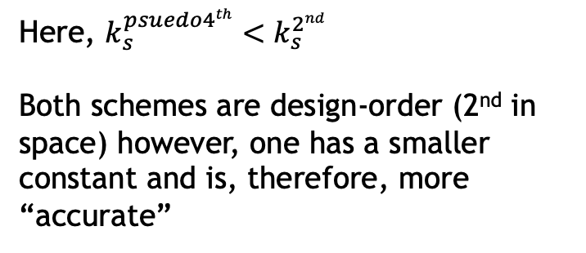
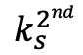
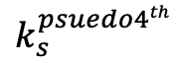
Verification Process Review
Recall that for a transient advection/diffusion system, the error includes contributions from spatial and temporal discretization approaches,
The constants define the relative accuracy between a collection of design-order methods
Here, $k_{s}^{psuedo4th}<k_{s}^{2nd}$
Both schemes are design-order (2nd in space) however, one has a smaller constant and is, therefore, more “accurate”
$$k_{s}^{2nd}$$
$$k_{s}^{psuedo4th}$$

Slide 22
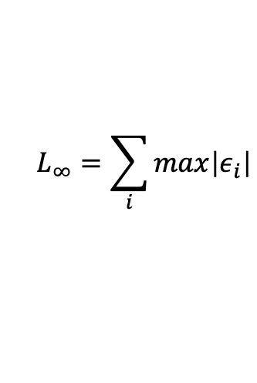
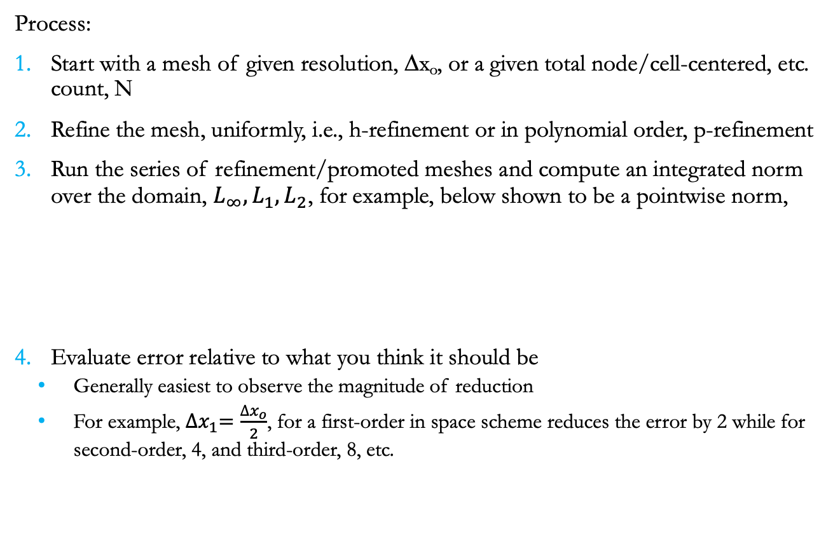
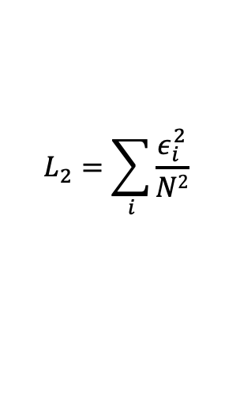
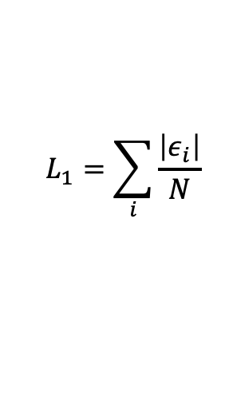
Spatial Verification Process
Process:
Start with a mesh of given resolution, Δx_{o}, or a given total node/cell-centered, etc. count, N
Refine the mesh, uniformly, i.e., h-refinement or in polynomial order, p-refinement
Run the series of refinement/promoted meshes and compute an integrated norm over the domain, $L_{∞}, L_{1}, L_{2}$, for example, below shown to be a pointwise norm,
Evaluate error relative to what you think it should be
Generally easiest to observe the magnitude of reduction
For example, ${∆x}_{1}=\frac{{∆x}_{o}}{2}$, for a first-order in space scheme reduces the error by 2 while for second-order, 4, and third-order, 8, etc.
$$L_{∞}=\sum_{i}{max\left|ε_{i}\right|}$$
$$L_{1}=\sum_{i}{\frac{\left|ε_{i}\right|}{N}}$$
$$L_{2}=\sum_{i}{\frac{ε_{i}^{2}}{N2}}$$

Slide 23
Spatial Verification Process
Process:
Start with a mesh of given resolution, Δx_{o}, or a given total node/cell-centered, etc. count, N
Refine the mesh, uniformly, i.e., h-refinement or in polynomial order, p-refinement
Run the series of refinement/promoted meshes and compute an integrated norm over the domain, $L_{∞}, L_{1}, L_{2}$, for example, below shown to be a pointwise norm,
Evaluate error relative to what you think it should be
Generally easiest to observe the magnitude of reduction
For example, ${∆x}_{1}=\frac{{∆x}_{o}}{2}$, for a first-order in space scheme reduces the error by 2 while for second-order, 4, and third-order, 8, etc.
$$L_{∞}=\sum_{i}{max\left|ε_{i}\right|}$$
$$L_{1}=\sum_{i}{\frac{\left|ε_{i}\right|}{N}}$$
$$L_{2}=\sum_{i}{\frac{ε_{i}^{2}}{N2}}$$

Slide 24
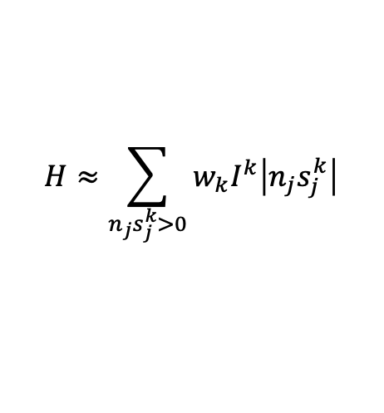

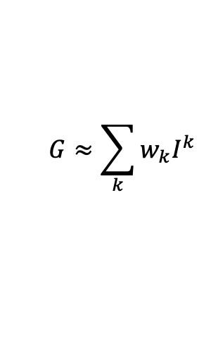
Lurking, or Hidden Errors…
In some numerical implementations, an error can exist that is not easily found at a given mesh resolution
For example:
There may be a boundary error that manifests itself locally at a very small subset of the mesh
There may be an error that is a driven by the fidelity of the mesh (consider our specified pressure drop in a pipe example)
Other errors, e.g., for a discrete-ordinance method, we have an underlying quadrature error
${ s}_{j}^{k}\frac{∂I^{k}}{∂x_{j}}+\left(μ_{a}+μ_{s}\right)$ $I^{k}=\frac{μ_{a}σT^{4}}{π}$+ $\frac{μ_{s}G}{4π}$
s^{k}_{j}
$$H≈\sum_{n_{j}s_{j}^{k}>0}{w_{k}I^{k}\left|n_{j}s_{j}^{k}\right|}$$
$$G≈\sum_{k}{w_{k}I^{k}}$$

Slide 25
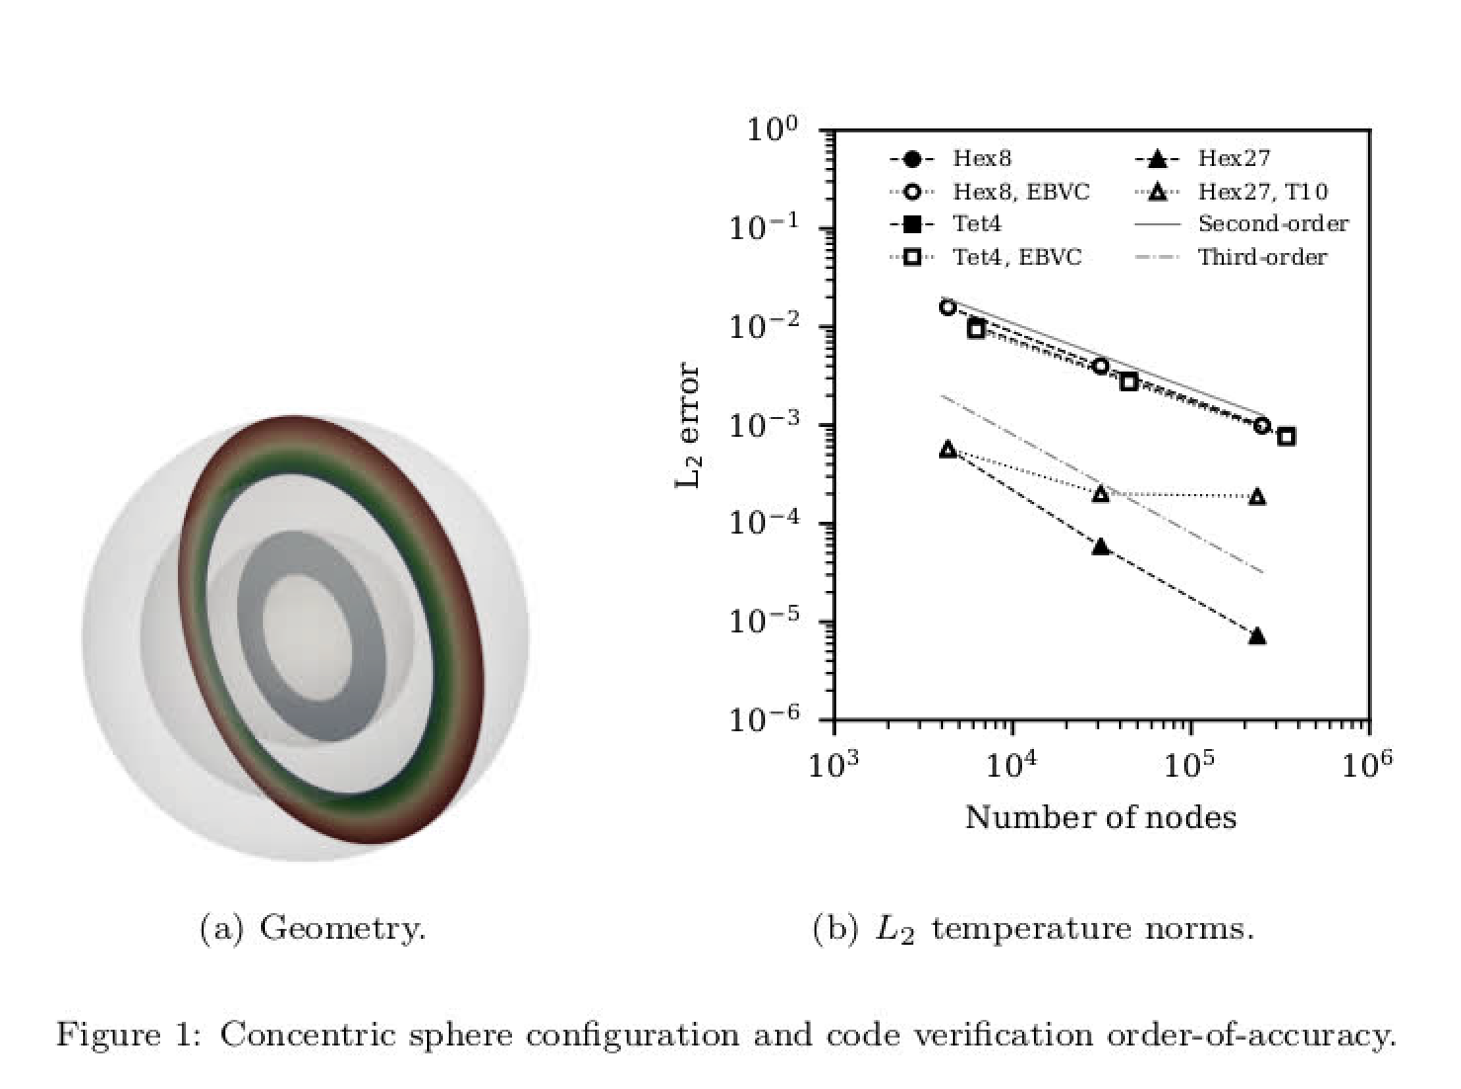
Lurking, or Hidden Errors…
In some numerical implementations, an error can exist that is not easily found at a given mesh resolution
For example:
There may be a boundary error that manifests itself locally at a very small subset of the mesh
There may be an error that is a driven by the fidelity of the mesh (consider our specified pressure drop in a pipe example)
Other errors, e.g., for a discrete-ordinance method, we have an underlying quadrature error
${ s}_{j}^{k}\frac{∂I^{k}}{∂x_{j}}+\left(μ_{a}+μ_{s}\right)$ $I^{k}=\frac{μ_{a}σT^{4}}{π}$+ $\frac{μ_{s}G}{4π}$
s^{k}_{j}
$$H≈\sum_{n_{j}s_{j}^{k}>0}{w_{k}I^{k}\left|n_{j}s_{j}^{k}\right|}$$
$$G≈\sum_{k}{w_{k}I^{k}}$$

Slide 26
Lurking, or Hidden Errors…
In some numerical implementations, an error can exist that is not easily found at a given mesh resolution
For example:
There may be a boundary error that manifests itself locally at a very small subset of the mesh
There may be an error that is a driven by the fidelity of the mesh (consider our specified pressure drop in a pipe example)
Other errors, e.g., for a discrete-ordinance method, we have an underlying quadrature error
${ s}_{j}^{k}\frac{∂I^{k}}{∂x_{j}}+\left(μ_{a}+μ_{s}\right)$ $I^{k}=\frac{μ_{a}σT^{4}}{π}$+ $\frac{μ_{s}G}{4π}$
s^{k}_{j}
$$H≈\sum_{n_{j}s_{j}^{k}>0}{w_{k}I^{k}\left|n_{j}s_{j}^{k}\right|}$$
Quadrature error at given quadrate order
$$G≈\sum_{k}{w_{k}I^{k}}$$

Slide 27
Lurking, or Hidden Errors…
In some numerical implementations, an error can exist that is not easily found at a given mesh resolution
For example:
There may be a boundary error that manifests itself locally at a very small subset of the mesh
There may be an error that is a driven by the fidelity of the mesh (consider our specified pressure drop in a pipe example)
Other errors, e.g., for a discrete-ordinance method, we have an underlying quadrature error
insensitive
${ s}_{j}^{k}\frac{∂I^{k}}{∂x_{j}}+\left(μ_{a}+μ_{s}\right)$ $I^{k}=\frac{μ_{a}σT^{4}}{π}$+ $\frac{μ_{s}G}{4π}$
s^{k}_{j}
$$H≈\sum_{n_{j}s_{j}^{k}>0}{w_{k}I^{k}\left|n_{j}s_{j}^{k}\right|}$$
Quadrature error at given quadrate order
$$G≈\sum_{k}{w_{k}I^{k}}$$

Slide 28
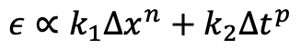
Temporal Verification: Fixed Spatial Resolution; Reduced Timestep
On a given mesh, compute error at a given time
$$ε∝k_{1}∆x^{n}+k_{2}∆t^{p}$$

Slide 29
Temporal Verification: Fixed Spatial Resolution; Reduced Timestep
On a given mesh, compute error at a given time
$$ε∝k_{1}∆x^{n}+k_{2}∆t^{p}$$

Slide 30
Temporal Verification: Fixed Spatial Resolution; Reduced Timestep
On a given mesh, compute error at a given time
$$ε∝k_{1}∆x^{n}+k_{2}∆t^{p}$$

Slide 31
Temporal Verification: Fixed Spatial Resolution; Reduced Timestep
On a given mesh, compute error at a given time
Fixed and eventually manifests itself
$$ε∝k_{1}∆x^{n}+k_{2}∆t^{p}$$

Slide 32
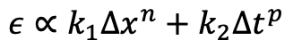
Temporal Verification: Reduction of Timestep as Mesh Is Refined
On a series of uniform mesh refinements, compute error at a given time while reducing time step
Must ensure that the spatial error does not dominate
Think about the timestep reduction requirement….
$$ε∝k_{1}∆x^{n}+k_{2}∆t^{p}$$
P1/P1
P2/P2
P1/P2
P2/P1
Traveling Vortex

Slide 33
Temporal Verification: Reduction of Timestep as Mesh Is Refined
Wait!! What is going on in this non-conformal configuration….
A P2 basis (quadratic) is reducing to second-order
Spatial or temporal error?
P1/P1
P2/P2
P1/P2
P2/P1
Traveling Vortex

Slide 34
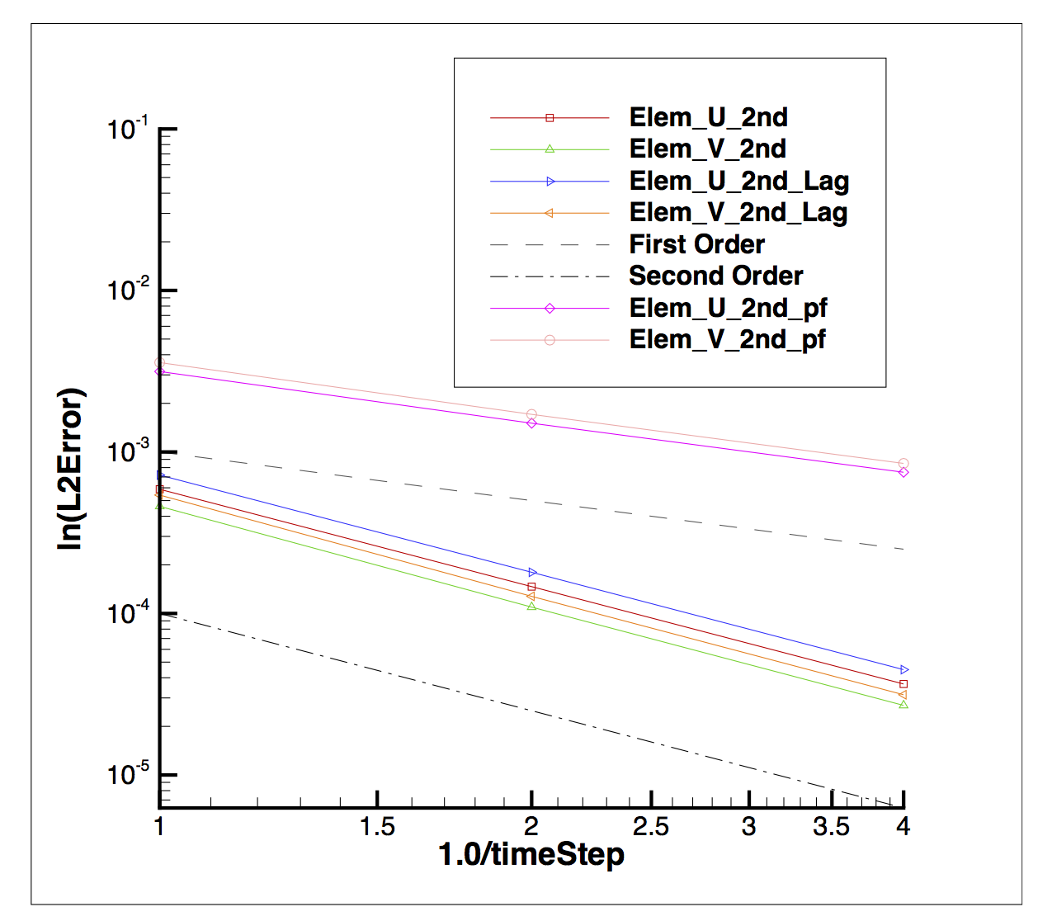
Essentials of Code Verification: Review
Taxonomy: One verifies code and validates models
Code verification establishes the numerical accuracy of the underlying discretization for the given partial differential equation set
Code verification seeks to provide the temporal and spatial accuracy of the underlying discretization approach
For temporal discretization error,
a two-state Backward Euler time integrator should be first-order in time, specifically the error should scale with Δt
a three-state BDF2 time integrator should scale with Δt²
a multi-stake Runga-Kutta schemes can achieve higher-order accuracy
For spatial discretization error, a method is design-order if the observed order of accuracy is Δx^{P+1}, where P is the underlying polynomial order for interpolation

Slide 35
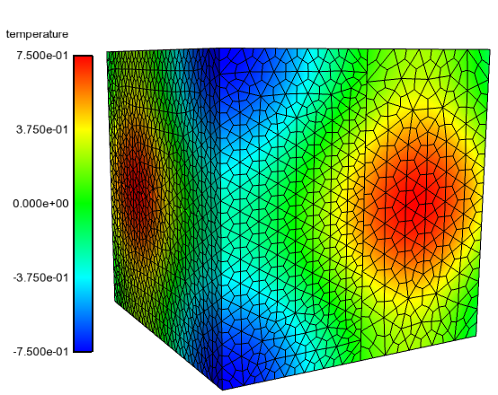
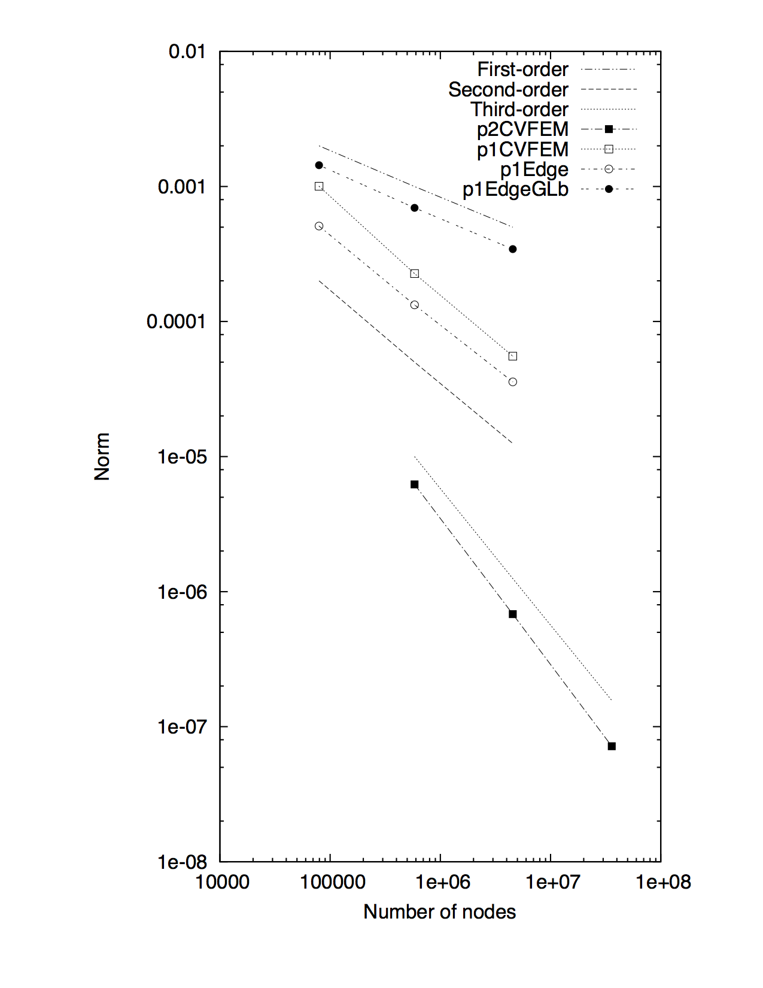
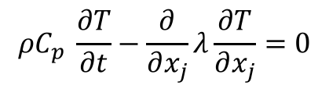
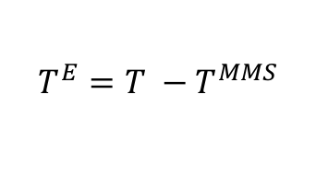
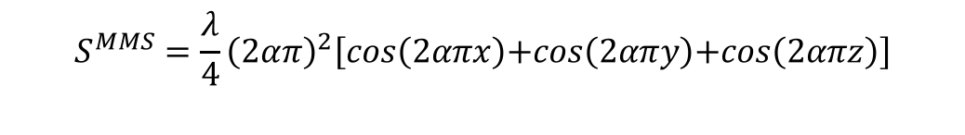
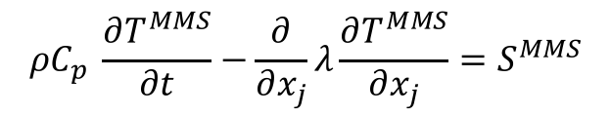
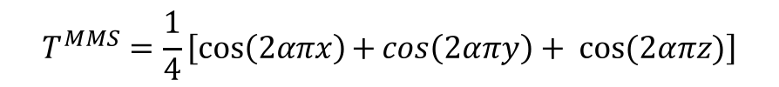
Review of the Method of Manufactured Solutions (MMS)
Providing confidence that the code implementation converges to the proper solution
For complex low-Mach fluid flow applications, there are very few analytical solutions
Consider an approach whereby the solution is manufactured (Roache, et al, 1990)
Simple thermal heat conduction PDE:
with manufactured analytical form for T:
Placing this MMS back into model PDE:
provides the source term:
with error now provided by:
$$ρC_{p} \frac{∂T}{∂t}−\frac{∂}{∂x_{j}}λ\frac{∂T}{∂x_{j}}=0$$
$$T^{MMS}=\frac{1}{4}\left[\cos\left(2απx\right)\text{+}\cos\left(2απy\right)+ cos⁡(2απz)\right]$$
$$ρC_{p} \frac{∂T^{MMS}}{∂t}−\frac{∂}{∂x_{j}}λ\frac{∂T^{MMS}}{∂x_{j}}=S^{MMS}$$
$$S^{MMS}=\frac{λ}{4}{\left(2απ\right)}^{2}\left[cos\left(2απx\right)\text{+}cos\left(2απy\right)\text{+}cos\left(2απz\right)\right]$$
$$T^{E}={T −T}^{MMS}$$
Physics-based approaches…

Slide 36
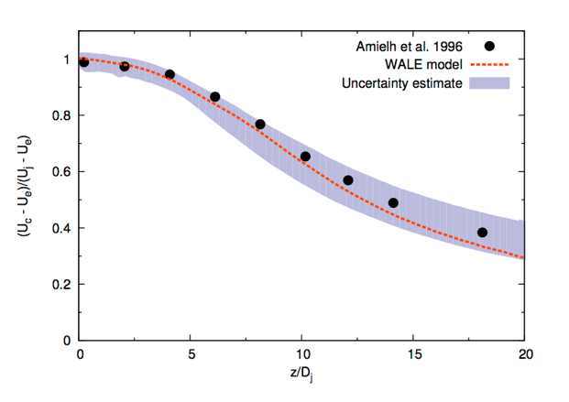
Improved VVUQ: Automatic Structural Uncertainty – Possible Modeling Improvement through Machine-Learning?
Previous LES validation studies, e.g., cylinder in x-flow, three models were implemented and tested (verified and maintained in the code repository)
Is there a more efficient approach? Yes! Eigenvalue perturbation of the SGS stress (extension of RANS-based approach: Emory et al., Phys. Fluids, 2017)
Barycentric triangle (see Lumley and Newman, J. Fluid Mech., 1977)
Open jet
Jofre, Domino, and Iaccarino, Flow Turb. Comb, 2018 (plane turbulent channel)
Jofre, Domino, and Iaccarino, Int. J. Heat & Fluid Flow, 2019 (turbulent axisymmetric jet)

Slide 37
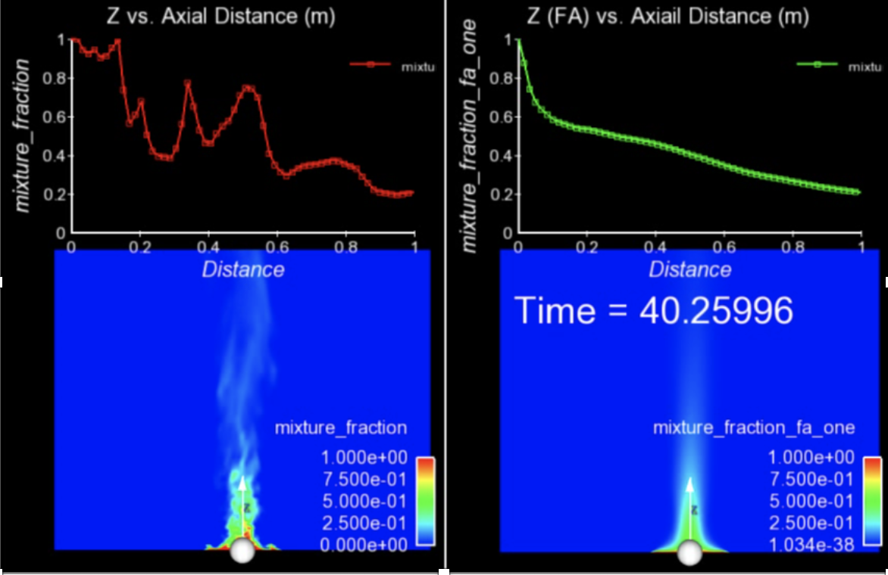
Finally…. For Transient, Turbulent Flows, Averaging is Required
The bane of turbulent validation: converged statistics require many flow-through times
Statistical convergence of a given simulation may require many flow-through-times; additional source of uncertainty and/or requirement for quantification of solution convergence

Slide 38
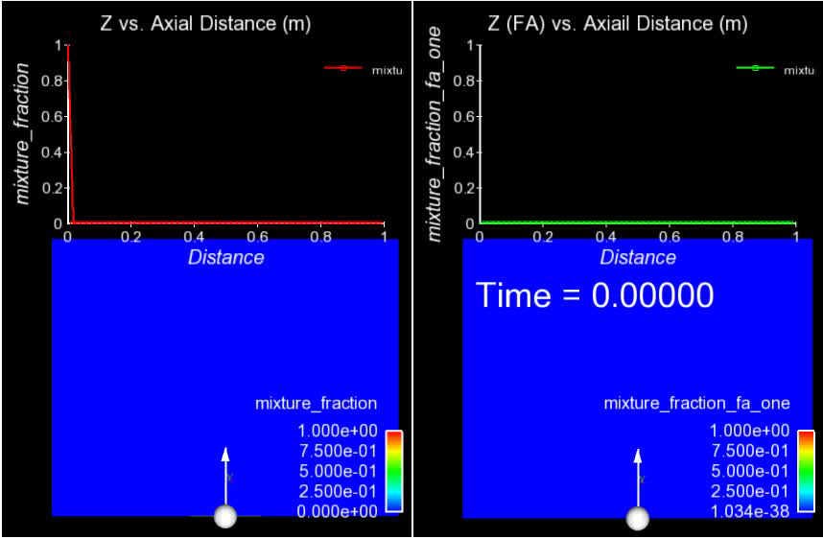
For Transient, Turbulent Flows, Averaging is Required
The bane of turbulent validation: converged statistics require many flow-through times

Slide 39
A Validation Methodology: Code and Solution Verification: Conclusions
A validation pedigree includes understanding what models are to be implemented, what code verification is required, and a detailed solution verification
A PIRT is a simple process that identifies gaps in models, code, and/or, validation
Typical validation studies often include one mesh, one model and lack of any code verification
As a general rule, it takes 10x longer to verify correctness than to implement the code capability
Code verification is hard work, however, is critical to numerical methods development
Violations of this rule are abundant– especially when the code implementation is really really hard, e.g., NGP on GPU

Slide 40
Design-order Mesh Constructs for Non-Conformal Interfaces
Non-conformal and overset methods provides ease of meshing and, when required, mesh motion
Design-order hybrid DG/CVFEM established, see: Domino, JCP, 2018
Non-conformal MMS

Slide 41
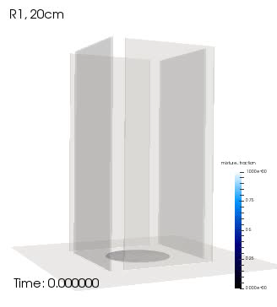
Objective: Deploy a High-Fidelity Tool to Predict a Fire
Consider that we want to develop and deploy a foundational understanding in fire physics and deploy a simulation tool to support production analysis
Consider the fire-environment with elements of the following physics:
Chemical reactions, soot, buoyancy, turbulent fluid mechanics, thermal radiation heat transfer, convective heat transfer, object heat-up/response, and sometimes propellants
Volume rendered mixture fraction

